Slide 1

ML4EO Workshop
Machine Learning for Earth Observation
9,16,23, and 30 July 2021

Slide 2
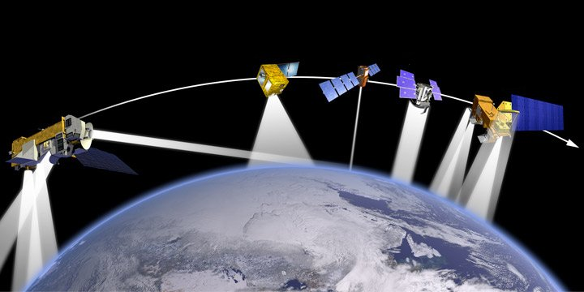
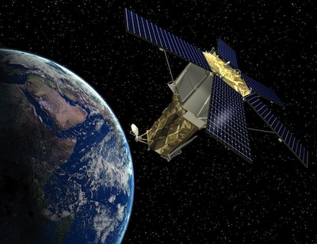
What is it?
ML4EO: Machine Learning for Earth Observation
Training of trainers workshop developed by Radiant Earth: https://www.radiant.earth
Capacity development in Africa
10 individual lectures
We will cover the work in 4 days of 3 hours each.
Different backgrounds of attendees – some of the information will be very familiar to some of you, some will be new.
At the end of the workshop: e-mail ML4EO organisers confirming that you were trained. (This ensures I get my training-of-trainers certificate!)

Slide 3
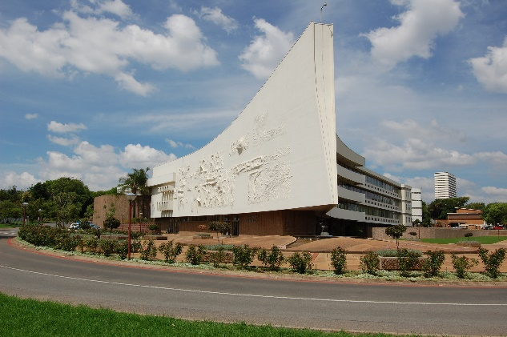
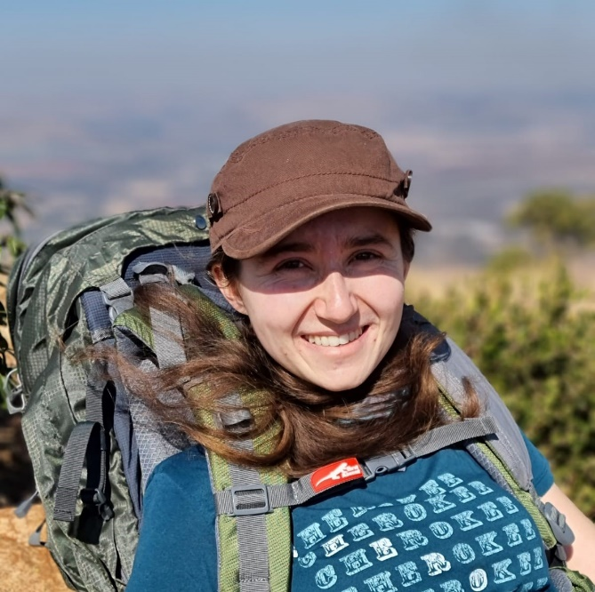



Who am I?
Renate Thiede
PhD student & part-time lecturer at UP Statistics Department
Research in spatial statistics with application to human mobility
Lecture undergrads and co-supervise postgrad students
Obligatory interesting fact: I write adventure stories in my spare time
LinkedIn: https://www.linkedin.com/in/renate-thiede/
Twitter: @RenateThiede

Slide 4
How will it work? (Overview)
10 individual lectures
We will cover the work in 4 days of 3 hours each.
Different backgrounds of attendees – some of the information will be very familiar to some of you, some will be new.
At the end of the workshop: e-mail ML4EO organisers confirming that you were trained. (This ensures I get my training-of-trainers certificate!)

Slide 5
How will it work? (Detail)
All materials available on GitHub: https://github.com/RadiantMLHub/ml4eo-bootcamp-2021
You are welcome to clone the repository and work locally, especially if you are comfortable with GitHub and Python.
You will need Python 3.8 – see the readme in GitHub for dependencies.
Most of the work is available in Bindr or Google Colab.
I will be running the programs in the cloud, as provided by the workshop organisers, to minimise issues with Python installation.

Slide 6
Lectures (as on GitHub)
“Lecture 11 Effective teaching” is not in scope, but you are welcome to go through it on your own time.
Lecture 1: Introduction to remote sensing of Earth
Lecture 2: Creating training datasets
Lecture 3: Introduction to machine learning
Lecture 4: Clustering and classification
Lecture 5: Intro to STAC + Radiant MLHub
Lecture 6: A hands-on training for machine learning in Python
Lecture 7: An introduction to machine learning with Digital Earth Africa
Lecture 8: Machine learning applications in land cover mapping
Lecture 9: Crop detection from satellite imagery using deep learning
Lecture 10: Tropical cyclone wind estimation from satellite imagery

Slide 7
Our Lectures (adaptable)
Day 1 (9 July):
Session 1: Intro to the workshop
Session 2: Lecture 1
Session 3: Lecture 2
Day 2 (16 July):
Session 1: Lecture 3
Session 2: Lecture 4
Session 3: Lecture 5
Day 3 (23 July):
Session 1: Lecture 6
Session 2: Lecture 7
Session 3: Lecture 8
Day 4 (30 July):
Session 1: Lecture 9
Session 2: Lecture 10
Session 3: Discussion
This structure is flexible; some topics might go quicker while others may take longer; we will see what happens!
The program can be found here: https://github.com/renatet/ML4EO-Resources

Slide 8
Finally...
This workshop is supposed to be interactive!
No point to just repeat the slides & notebooks word-for-word – we wouldn’t need a workshop in that case...
The materials are available indefinitely, so you can always go back to them in your own time (especially if you clone/download them).
The value of these sessions will be in the discussions we have.
So feel free to comment and interject as we go along!

